Slide 1
Hashing
CENG 213 Data Structures

Slide 2
Hash Tables
We’ll discuss the hash table ADT which supports only a subset of the operations allowed by binary search trees.
The implementation of hash tables is called hashing.
Hashing is a technique used for performing insertions, deletions and finds in constant average time (i.e. O(1))
This data structure, however, is not efficient in operations that require any ordering information among the elements, such as findMin, findMax and printing the entire table in sorted order.
CENG 213 Data Structures

Slide 3
General Idea
The ideal hash table structure is merely an array of some fixed size, containing the items.
A stored item needs to have a data member, called key, that will be used in computing the index value for the item.
  Key could be an integer, a string, etc
  e.g. a name or Id that is a part of a large employee structure
The size of the array is TableSize.
The items that are stored in the hash table are indexed by values from 0 to TableSize – 1.
Each key is mapped into some number in the range 0 to TableSize – 1.
The mapping is called a hash function.
CENG 213 Data Structures

Slide 4
Example
Hash
Table
0
1
Items
Hash
Function
2
john 25000
3
john 25000
phil 31250
key
4
phil 31250
dave 27500
5
mary 28200
6
dave 27500
7
mary 28200
key
8
9
CENG 213 Data Structures

Slide 5
Hash function
Problems:
Keys may not be numeric.
Number of possible keys is much larger than the space available in table.
How to decide table size, hash func, hash map code
Different keys may map into same location
  Hash function is not one-to-one => collision.
  If there are too many collisions, the performance of the hash table will suffer dramatically.
CENG 213 Data Structures

Slide 6
Hash Functions
If the input keys are integers then simply Key mod TableSize is a general strategy.
  Unless key happens to have some undesirable properties. (e.g. all keys end in 0 and we use mod 10)
If the keys are strings, hash function needs more care.
  First convert it into a numeric value.
CENG 213 Data Structures

Slide 7
Some methods
Truncation:
  e.g. 123456789 map to a table of 1000 addresses by picking 3 digits of the key.
Folding:
  e.g. 123|456|789: add them and take mod.
Key mod N:
  N is the size of the table, better if it is prime.
Squaring:
  Square the key and then truncate
CENG 213 Data Structures

Slide 8
Hash Function 1
Add up the ASCII values of all characters of the key.
int hash(const string &key, int tableSize)
{
int hasVal = 0;
for (int i = 0; i < key.length(); i++)
hashVal += key[i];
return hashVal % tableSize;
}
Many words have the same sum
if the table size is large, the function does not distribute the keys well.
  e.g. Table size =10000, key length <= 8, the hash function can assume values only between 0 and 1016 (127*8) where 127 is largest integer value for a char.

Slide 9
Hash Function 2
Examine only the first 3 characters of the key.
int hash (const string &key, int tableSize)
{
return (key[0]+27 * key[1] + 729*key[2]) % tableSize;
}
In theory, 26 * 26 * 26 = 17576 different words can be generated. However, English is not random, only 2851 different combinations are possible.
Thus, this function although easily computable, is also not appropriate if the hash table is reasonably large.
CENG 213 Data Structures

Slide 10
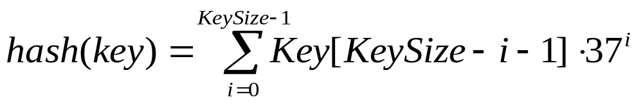
Hash Function 3
int hash (const string &key, int tableSize)
{
int hashVal = 0;
for (int i = 0; i < key.length(); i++)
hashVal = 37 * hashVal + key[i];
hashVal %=tableSize;
if (hashVal < 0) /* in case overflows occurs */
hashVal += tableSize;
return hashVal;
};
CENG 213 Data Structures

Slide 11
Hash function for strings:
98
108
105
key[i]
key
a
l
i
0 1 2
i
KeySize = 3;
hash(“ali”) = (105 * 1 + 108*37 + 98*37²) % 10,007 = 8172
0
hash
function
1
2
“ali”
……
ali
8172
……
10,006 (TableSize)
CENG 213 Data Structures

Slide 12
Hash Code map
Horners Rule with x=33,37,39,41 experimentally found
to give 6 collisions among words in the English dictionary
CENG 213 Data Structures

Slide 13
Compression Code
Examples
H(k)=k mod m
Pick m to be prime to avoid dependency on last few characters
Based on how much load you want to give each cell (k)
in the chain you can nearest prime at n/k
H(k)=m(k A mod 1) for 0<A<1
H(k)= (ak + b) mod m where a and m should be co-prime
Universal Hashing: Pick out of a bunch of hashes at random for one
round of hash table filling.
CENG 213 Data Structures

Slide 14
Collision Resolution
If, when an element is inserted, it hashes to the same value as an already inserted element, then we have a collision and need to resolve it.
There are several methods for dealing with this:
  Separate chaining
  Open addressing
    Linear Probing
    Quadratic Probing
    Double Hashing
CENG 213 Data Structures

Slide 15
Separate Chaining
The idea is to keep a list of all elements that hash to the same value.
  The array elements are pointers to the first nodes of the lists.
  A new item is inserted to the front of the list.
Advantages:
  Better space utilization for large items.
  Simple collision handling: searching linked list.
  Overflow: we can store more items than the hash table size.
  Deletion is quick and easy: deletion from the linked list.
CENG 213 Data Structures

Slide 16
Example
Keys: 0, 1, 4, 9, 16, 25, 36, 49, 64, 81
hash(key) = key % 10.
0
0
1
81
1
2
3
4
64
4
5
25
6
36
16
7
8
9
49
9
CENG 213 Data Structures

Slide 17
Operations
Initialization: all entries are set to NULL
Find:
  locate the cell using hash function.
  sequential search on the linked list in that cell.
Insertion:
  Locate the cell using hash function.
  (If the item does not exist) insert it as the first item in the list.
Deletion:
  Locate the cell using hash function.
  Delete the item from the linked list.
CENG 213 Data Structures

Slide 18
Analysis of Separate Chaining
Collisions are very likely.
  How likely and what is the average length of lists?
Load factor λ definition:
  Ratio of number of elements (N) in a hash table to the hash TableSize.
    i.e. λ = N/TableSize
  The average length of a list is also λ.
  For chaining λ is not bound by 1; it can be > 1.
CENG 213 Data Structures

Slide 19
Cost of searching
Cost = Constant time to evaluate the hash function + time to traverse the list.
Unsuccessful search:
  We have to traverse the entire list, so we need to compare λ nodes on the average.
Successful search:
  List contains the one node that stores the searched item + 0 or more other nodes.
  Expected # of other nodes = x = (N-1)/M which is essentially λ, since M is presumed large.
  On the average, we need to check half of the other nodes while searching for a certain element
  Thus average search cost = 1 + λ/2
CENG 213 Data Structures

Slide 20
Summary
The analysis shows us that the table size is not really important, but the load factor is.
TableSize should be as large as the number of expected elements in the hash table.
  To keep load factor around 1.
TableSize should be prime for even distribution of keys to hash table cells.
CENG 213 Data Structures

Slide 21
Hashing: Open Addressing
CENG 213 Data Structures

Slide 22
Collision Resolution with
Open Addressing
Separate chaining has the disadvantage of using linked lists.
  Requires the implementation of a second data structure.
In an open addressing hashing system, all the data go inside the table.
  Thus, a bigger table is needed.
    Generally the load factor should be below 0.5.
  If a collision occurs, alternative cells are tried until an empty cell is found.
CENG 213 Data Structures

Slide 23
Open Addressing
More formally:
  Cells h₀(x), h₁(x), h₂(x), …are tried in succession where h_{i}(x) = (hash(x) + f(i)) mod TableSize, with f(0) = 0.
  The function f is the collision resolution strategy.
There are three common collision resolution strategies:
  Linear Probing
  Quadratic probing
  Double hashing
CENG 213 Data Structures

Slide 24
Linear Probing
In linear probing, collisions are resolved by sequentially scanning an array (with wraparound) until an empty cell is found.
  i.e. f is a linear function of i, typically f(i)= i.
  In other words: Linear probing is when the interval between two successive probes is fixed. Usually at 1. Not necessarily
Example:
  Insert items with keys: 89, 18, 49, 58, 9 into an empty hash table.
  Table size is 10.
  Hash function is hash(x) = x mod 10.
    f(i) = i;
CENG 213 Data Structures

Slide 25
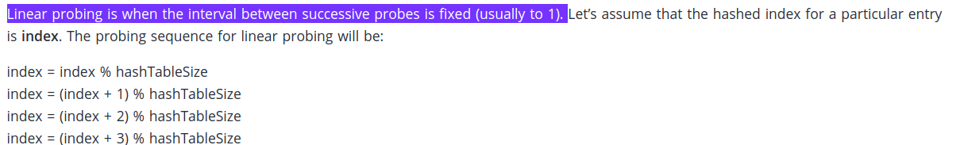
CENG 213 Data Structures

Slide 26
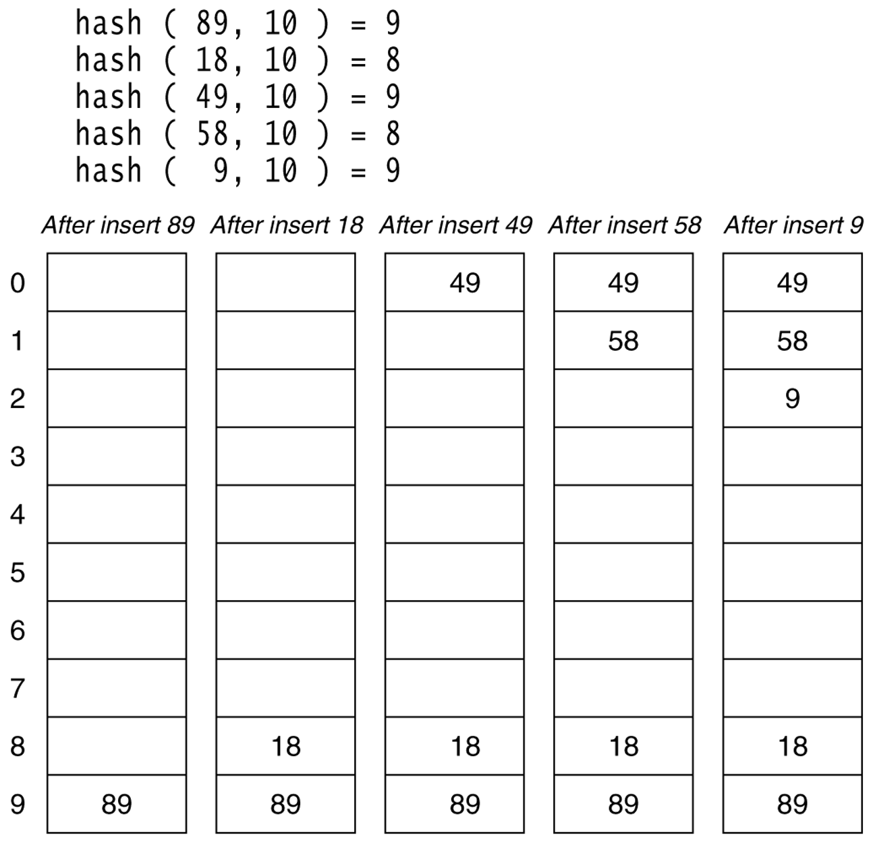
Figure 20.4
Linear probing hash table after each insertion
CENG 213 Data Structures

Slide 27
Find and Delete
The find algorithm follows the same probe sequence as the insert algorithm.
  A find for 58 would involve 4 probes.
  A find for 19 would involve 5 probes.
We must use lazy deletion (i.e. marking items as deleted)
  Standard deletion (i.e. physically removing the item) cannot be performed.
  e.g. remove 89 from hash table.
CENG 213 Data Structures

Slide 28
Clustering Problem
As long as table is big enough, a free cell can always be found, but the time to do so can get quite large.
Worse, even if the table is relatively empty, blocks of occupied cells start forming.
This effect is known as primary clustering.
Any key that hashes into the cluster will require several attempts to resolve the collision, and then it will add to the cluster.
CENG 213 Data Structures

Slide 29
Quadratic Probing
Quadratic Probing eliminates primary clustering problem of linear probing.
Collision function is quadratic.
  The popular choice is f(i) = i².
If the hash function evaluates to h and a search in cell h is inconclusive, we try cells h + 1², h+2², … h + i².
  i.e. It examines cells 1,4,9 and so on away from the original probe.
Remember that subsequent probe points are a quadratic number of positions from the original probe point.
CENG 213 Data Structures

Slide 30
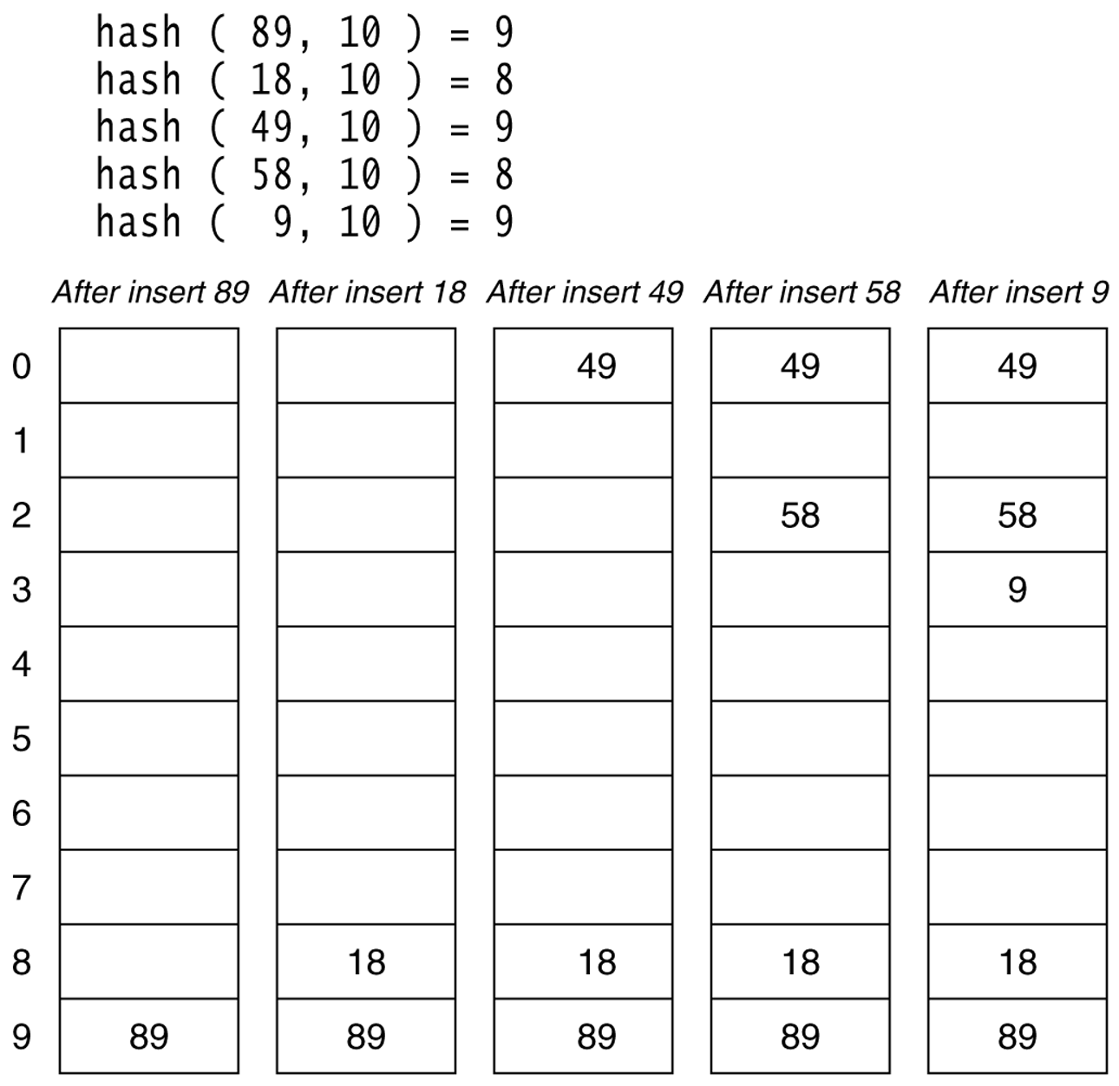
Figure 20.6
A quadratic probing hash table after each insertion (note that the table size was poorly chosen because it is not a prime number).
CENG 213 Data Structures

Slide 31
Quadratic Probing
Problem:
  We may not be sure that we will probe all locations in the table (i.e. there is no guarantee to find an empty cell if table is more than half full.)
  If the hash table size is not prime this problem will be much severe.
However, there is a theorem stating that:
  If the table size is prime and load factor is not larger than 0.5, all probes will be to different locations and an item can always be inserted.
CENG 213 Data Structures

Slide 32
Theorem
If quadratic probing is used, and the table size is prime, then a new element can always be inserted if the table is at least half empty (at most half full).
Theorem: First ⎡M/2⎤ alternative locations are distinct. (Initial location too is distinct from the first m/2 alternate locations)
Conclusion: If initial and next m/2 probes are distinct then, an empty cell can be found provided the table is atmost half full(has only m/2 elements so far)
if m/2 elements are there then at most m/2 collisions when I try to insert element e but there are m/2+1 distinct locations (initial probe +m/2 so I will find one location where no element is there and I can insert.
CENG 213 Data Structures

Slide 33
Proof
Let M be the size of the table and it is prime. We show that the first ⎡M/2⎤ alternative locations are distinct.
Let two of these locations are h + i² and h + j², where i, j are two probes s.t. 0≤ i,j ≤ ⎣M/2⎦. Suppose for the sake of contradiction, that these two locations are the same but
i ≠ j. Then
h + i² = h + j² (mod M)
i² = j² (mod M)
i² - j² = 0 (mod M)
(i-j)(i+j) = 0 (mod M)
Because M is prime, either (i-j) or (i+j) is divisible by M. Neither of these possibilities can occur. Thus we obtain a contradiction.
It follows that the first ⎡M/2⎤ alternative are all distinct and since there are at most ⎣M/2⎦ items in the hash table it is guaranteed that an insertion must succeed if the table is at least half empty.
CENG 213 Data Structures
Notes:
Example if M is prime, and A * B mod M is 0 then either A or B is divisible by M. However if M not prime, as 12. Then I can have A=16 and B=6 such that A*B=96 mod 12 =0 but A and B are neither multiple of 12.

Slide 34
Some considerations
How efficient is calculating the quadratic probes?
  Linear probing is easily implemented. Quadratic probing appears to require * and % operations.
  However by the use of the following trick, this is overcome:
    H_{i} = H_{i-1}+2i – 1 (mod M)
CENG 213 Data Structures

Slide 35
Some Considerations
What happens if load factor gets too high?
  Dynamically expand the table as soon as the load factor reaches 0.5, which is called rehashing.
  Always double to a prime number.
  When expanding the hash table, reinsert the new table by using the new hash function.
CENG 213 Data Structures

Slide 36
Analysis of Quadratic Probing
Quadratic probing has not yet been mathematically analyzed.
Although quadratic probing eliminates primary clustering, elements that hash to the same location will probe the same alternative cells. This is know as secondary clustering.
Techniques that eliminate secondary clustering are available.
  the most popular is double hashing.
CENG 213 Data Structures

Slide 37
Double Hashing
A second hash function is used to drive the collision resolution.
  f(i) = i * hash₂(x)
We apply a second hash function to x and probe at a distance hash₂(x), 2*hash₂(x), … and so on.
The function hash₂(x) must never evaluate to zero.
  e.g. Let hash₂(x) = x mod 9 and try to insert 99 in the previous example.
A function such as hash₂(x) = R – ( x mod R) with R a prime smaller than TableSize will work well.
  e.g. try R = 7 for the previous example.(7 - x mode 7)
CENG 213 Data Structures

Slide 38
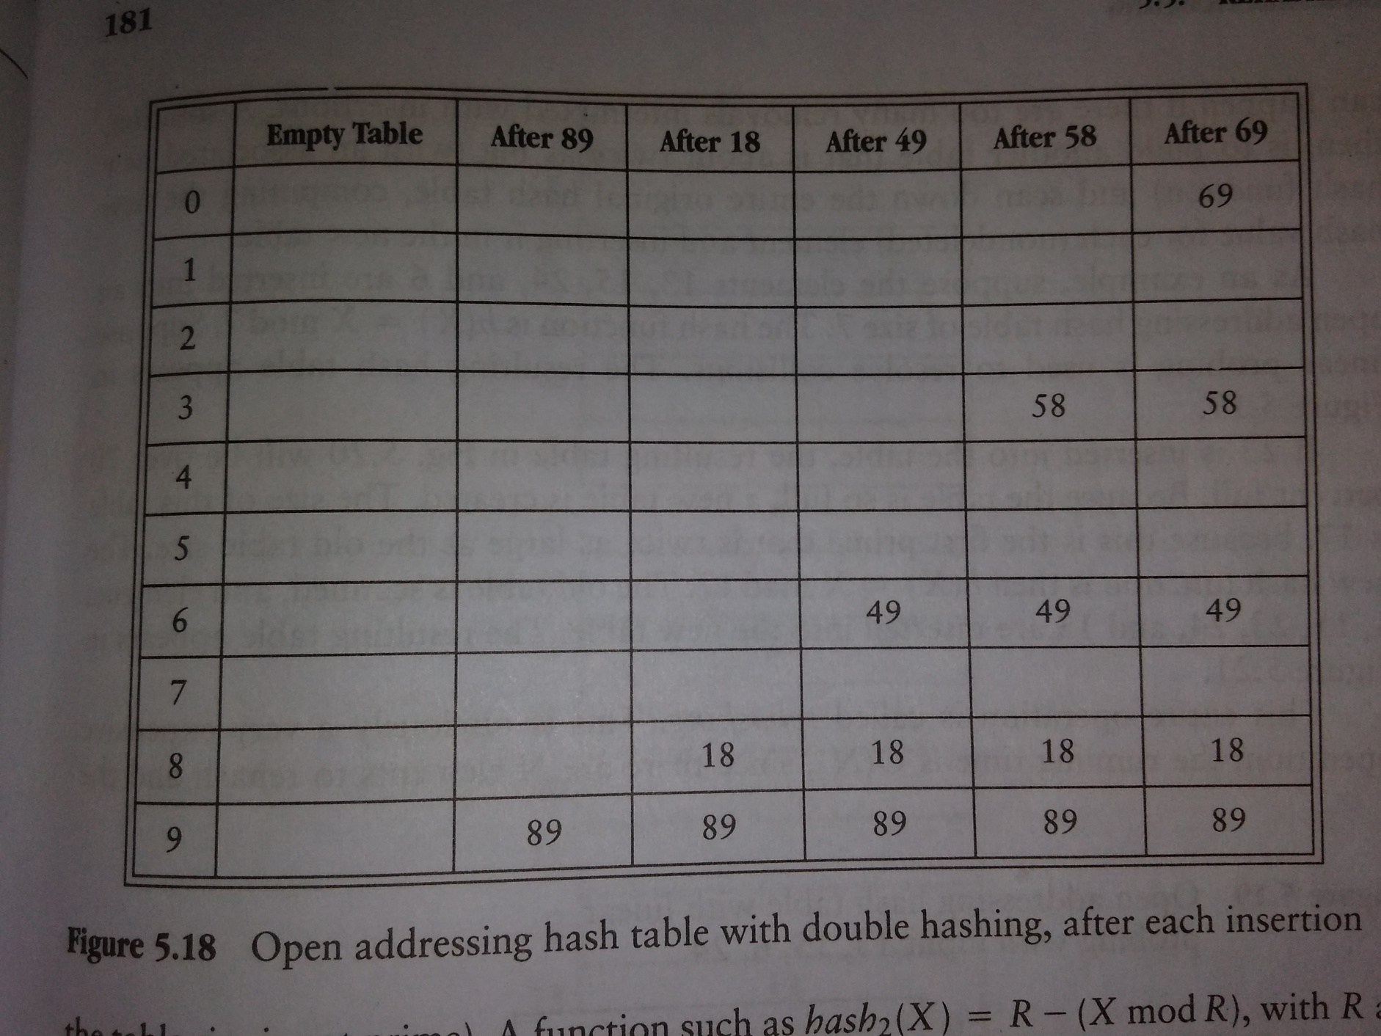
CENG 213 Data Structures

Slide 39
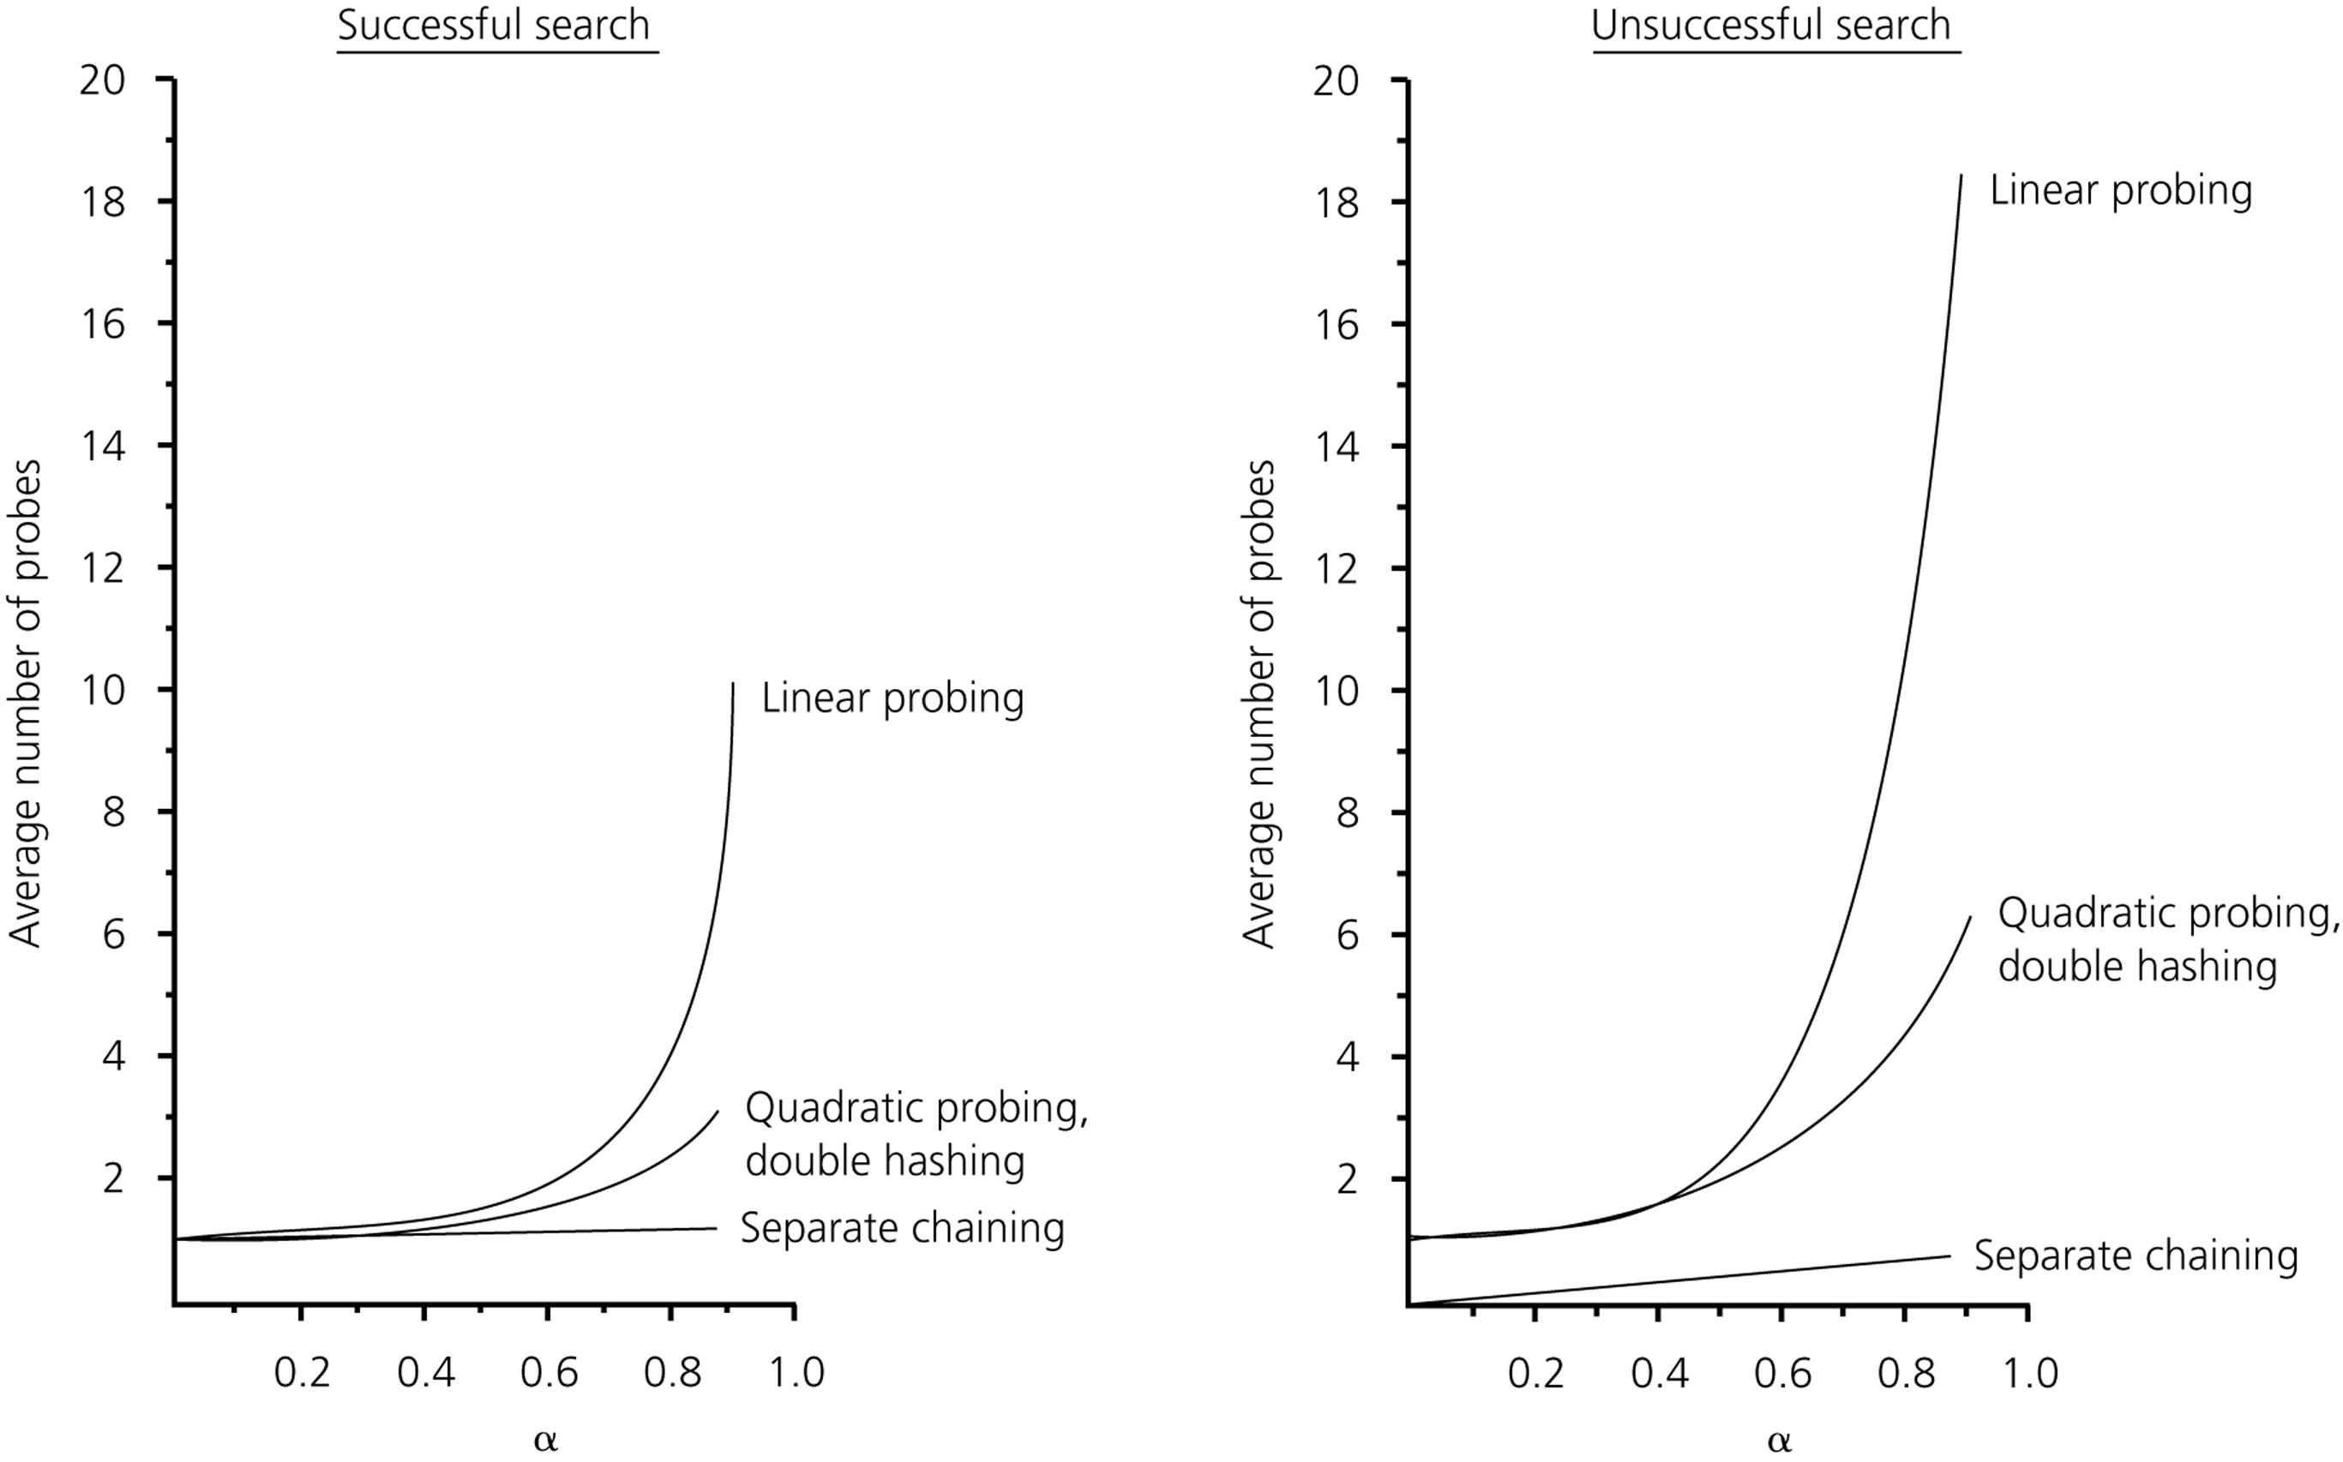
The relative efficiency of four collision-resolution methods
CENG 213 Data Structures

Slide 40
Hashing Applications
Compilers use hash tables to implement the symbol table (a data structure to keep track of declared variables).
Game programs use hash tables to keep track of positions it has encountered (transposition table)
Online spelling checkers.
CENG 213 Data Structures

Slide 41
Rehash of Hashing
Hashing is a great data structure for storing unordered data that supports insert, delete & find
Both separate chaining (open) and open addressing (closed) hashing are useful
  separate chaining flexible
  closed hashing uses less storage, but performs badly with load factors near 1
  extendible hashing for very large disk-based data
Hashing pros and cons
  + very fast
  + simple to implement, supports insert, delete, find
  - lazy deletion necessary in open addressing, can waste storage
  - does not support operations dependent on order: min, max, range

Slide 42
Hashing Applications
Compilers use hash tables to implement the symbol table (a data structure to keep track of declared variables).
Game programs use hash tables to keep track of positions it has encountered (transposition table)
Online spelling checkers.
CENG 213 Data Structures

Slide 43
Cuckoo Hashing
Use two hash tables.
To insert x
- if h1(x) empty then occupy
- else oust the element y occupying h1(x) and insert the ousted element to other hash table.
- keep repeating until an ousted element finds it place or you landing up in circles.
CENG 213 Data Structures

Slide 44
Summary
Hash tables can be used to implement the insert and find operations in constant average time.
  it depends on the load factor not on the number of items in the table.
It is important to have a prime TableSize and a correct choice of load factor and hash function.
For separate chaining the load factor should be close to 1.
For open addressing load factor should not exceed 0.5 unless this is completely unavoidable.
  Rehashing can be implemented to grow (or shrink) the table.
CENG 213 Data Structures

